Slide 1

Boulder Dash Java Project
Alexandre Tavernier – Bruno Doucet – Thomas Charpentier – Philippe Burlet

Slide 2
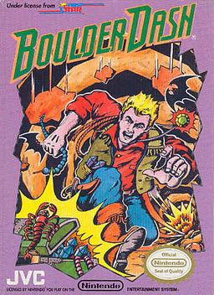
Summary
Boulder Dash
Features
Organization
How it works
Demo

Slide 3
Boulder Dash
Video game released in 1984 for the Atari 8bit
Create by First Star Software
Main character : Rockford
Official remake in 2014 for iOS and Android
2016 release on PC

Slide 4
Features
Player :
Control Rockford with the arrow
Dig the dirt
Push the boulder
Take the diamond
When all diamonds are taken the exit is open
When the player is hit by a boulder or an enemy is dead

Slide 5
Organization
MVC :
Model
View
Controller
Create de game while using package to clean the folder

Slide 6
How it works
Controller is for getting the control
The view print the game
Model link the controller and the view

Slide 7
Demo

Slide 8
Conclusion
Project at 80%
Kill player
Kill enemy
Refresh the view
Architecture review

